Slide 1

FACIAL JUSTICE: IDENTIFING CRIMINALS FOR A
SAFER SOCIETY
By
2011CS040005-A.Veena
2011CS040014-CH. Harsha Vardhan
2011CS040049-K.Sai Jayanth
Under the Guidance of
Mr. P. Ravinder
Department of Cyber Security
School of Engineering
Malla Reddy University
Hyderabad, Telangana, INDIA

Slide 2
ABSTRACT
Criminal record generally contains personal information about particular person along with photograph. To identify any Criminal, we need some identification regarding person, which are given by eyewitness. In most cases the quality and resolution of the recorded image segments is poor and hard to identify a face. To overcome this sort of problem we are developing software. Identification can be done in many ways like fingerprint, eyes, DNA etc. One of the applications is face identification. The face is our primary focus of attention in social inters course playing a major role in conveying identify and emotion. Although the ability to infer intelligence or character from facial appearance is suspect, the human ability to recognize face is remarkable.

Slide 3
1. Introduction
1.1 Problem Definition & Description
Problem specification :
One of the primary hurdles we face is the poor quality of images typically included in criminal records, which often hinder accurate face recognition.
Problem Description :
The project is aimed at identifying the criminals with the help of eyewitness. There are mainly four modules in our project. They are Adding, Deleting, Updating and identifying the criminals. There are mainly three roles in our project.
They are:
➢ Administrator
➢ Operator
➢ Eyewitness

Slide 4
1.2 Objectives of the Project
Aim of the project: This project is aimed to identify the criminals in any investigation department.
Tasks and deliverables:
This project is intended to identify a person using the images previously taken. The identification will be done according the previous images of different persons.
1.3 Scope of the project :
The scope of the project is confined to store the image and store in the database. When a person has to be identified the images stored in the database are compared with the existing details.
Determining goals:
Implement features that enable operators to collaborate with eyewitnesses during the facial reconstruction process, ensuring that the final composite face closely resembles the perpetrator as described by eyewitnesses.

Slide 5
Data & Constrains:
The criminal records contain personal information about individuals, including their name, age, and possibly other identifying details.
The accuracy of the composite face relies on the reliability and accuracy of eyewitness descriptions, which may vary
Workflow management strategies:
Workflow management strategies optimize efficiency and productivity. Key approaches include process automation, task prioritization, clear communication channels, and continuous monitoring. Through effective delegation, resource allocation, and streamlined procedures, workflows are streamlined, reducing bottlenecks and maximizing output while maintaining quality standards.

Slide 6
2. System Analysis
2.1 Existing System
Literature Survey:
SanikaRatnaparkhi, AamaniTandasi, Shipra Saraswat: The process of identifying and spotting criminals is slow and difficult. Using cutting-edge face recognition technology is a quick and simple option.
P Apoorva, H.C.Impana, S.L.Siri : This paper is real time face recognition using an automated surveillance camera. The proposed system consists of 4 steps including training of real time images, face detection using Haar-classifier, comparison of trained real time images with images from the surveillance camera, result based on the comparison
Limitations of Existing System:
This system is manual system only. Here, have a facility to store the criminal images. If you want to compare the criminal images with the existing images it is manual process. This process is very slow to give the result. It is very critical to find the criminal images.

Slide 7
2.2 Proposed System
To overcome the drawbacks that were in the existing system we develop a system that will be very useful for any investigation department. Here the program keeps track of the record number of each slice during the construction of identifiable human face and calculate maximum number of slices of the similar record number. Based on this record number the program retrieves the personal record of the suspect (whose slice constituted the major parts of the constructed human face) on exercising the “locate” option.
Advantages of Proposed System:
➢ Enhanced Efficiency: By automating tasks such as adding details, clipping images, and constructing faces, the software streamlines the identification process, saving valuable time and resources for law enforcement agencies.
➢ Improved Accuracy: Despite poor image quality, the software's advanced algorithms and facial recognition capabilities enhance the accuracy of identifying criminals, reducing the likelihood of false positives or wrongful accusations.
➢ Leveraging Human Recognition Abilities: While inferring intelligence or character from facial appearance may be challenging, the software capitalizes on the remarkable human ability to recognize faces, enhancing the effectiveness of criminal identification efforts

Slide 8
2.3 Software & Hardware Requirements
Software Requirements :
Operating System : Windows
Graphical User Interface : Java Swing, AWT.
Application Logic : Java 7.
Database : Oracle 10g
IDE/Workbench : My Eclipse 6.0
Hardware Requirements :
System Configuration:
Processor : Pentium III – 900 MHz
Hard Disk : 20 GB
RAM : 128 MB

Slide 9
2.4 Feasibility Study
Technical Feasibility:
The project is developed on Pentium III with 128 MB RAM.
The environment required in the development of system is any windows platform
The observer pattern along with factory pattern will update the results eventually
The language used in the development is JAVA 7 & Windows Environment
Economic Feasibility:
The system developed and installed will be good benefit to the organization. The system will be developed and operated in the existing hardware and software infrastructure. So, there is no need of additional hardware and software for the system.
Operational Feasibility:
This system can be implemented in the organization because there is adequate support from management and users. Being developed in Java so that the necessary operations are carried out automatically.

Slide 10
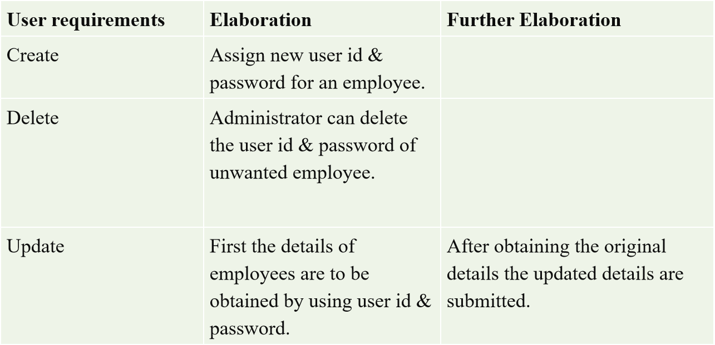
3. Architectural Design
3.1 Modules Design
3.1.1 User Interface Module: Actually, every application has one user interface for accessing the entire application. In this application also we are providing one user interface for accessing this application.
3.1.2 Admin Module:

Slide 11
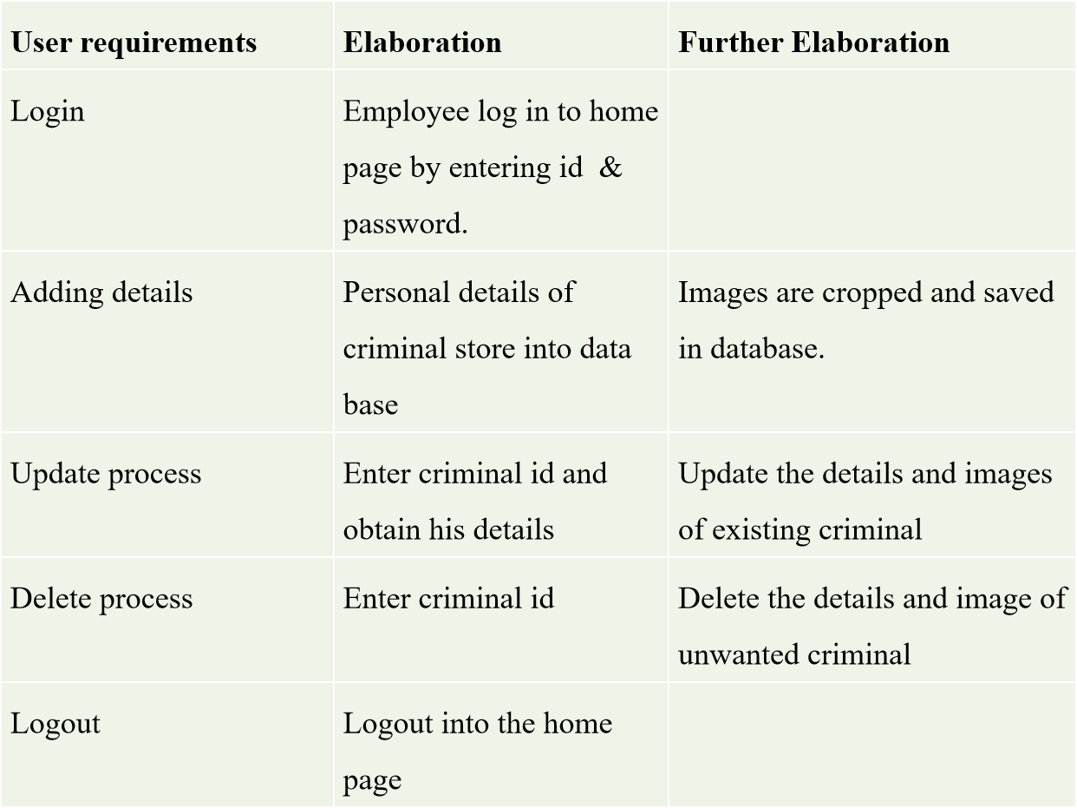
3.1.3 Client Module:

Slide 12
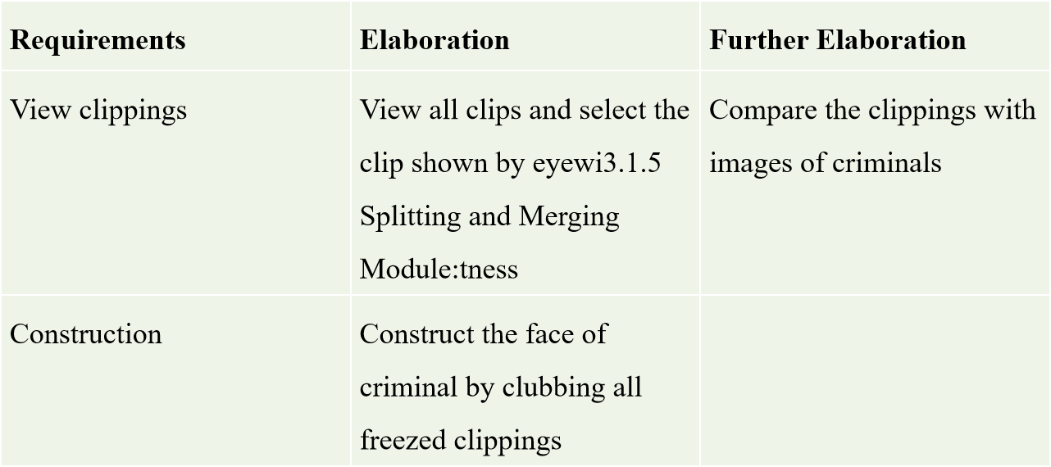
3.1.4 Database Operations Module:
ADD MODULE: The add module is helpful in adding the details of the criminals along with the details of the criminal photo.
DELETE MODULE: This module deletes the criminal details along with the photo.
UPDATE MODULE: The operator first enters the criminal id and searches for the availability of that id.
3.1.5 Splitting and Merging Module:

Slide 13
3.1.6 Identify Module:
The cropped parts of the criminals, along with the criminal Id are viewed by the eyewitness .The eyewitness selects particular cropped part of the criminal, and it is freeze by the operator., then complete face of the criminal is constructed, and criminal details are identified.
3.1.7 Testing Module:
The operator login status is successful, the segmented parts of the criminals, along with the criminal Id are viewed by the eyewitness .The eyewitness selects particular segmented slice of the criminal image, and it is selected by the operator, then complete face of the criminal is constructed and identified.
3.1.7 Results:
Eyewitness selects criminal's cropped part, operator freezes it, constructing full face for retrieval of criminal details.

Slide 14
3.2 Method & Algorithm design
3.2.1 Method :
1. Image Input:
Receive input images from various sources such as surveillance cameras or eyewitness accounts.
2. Preprocessing:
Enhance image quality through preprocessing techniques like noise reduction and normalization.
3. Feature Extraction:
Extract key facial features from preprocessed images, such as eyes, nose, and mouth.
4. Face Encoding:
Encode extracted facial features into a format suitable for comparison with other facial encodings.
5. Database Comparison:
Compare encoded facial features with a database of known faces, such as a criminal records database or a watchlist.
6. Matching and Identification:
Identify potential matches between input images and faces in the database.

Slide 15
3.2.2 Algorithm:
Initialize: Start the facial recognition system.
Preprocess Criminal Record: Extract facial features from the criminal's photograph and store them in the database along with personal information.
Process Image Segments: For each low-resolution image segment: Preprocess the segment. - Extract facial features from the segment.
Search Database: Compare the extracted features with those in the database.
Calculate Similarity: Calculate a similarity score between the extracted features and those in the database.
Check for Match: If the similarity score is above a predefined threshold: Output the matched criminal's personal information. Display the criminal's photograph.
No Match Found: If no match is found after searching through the entire database, output "No match found”.
End: End the algorithm

Slide 16
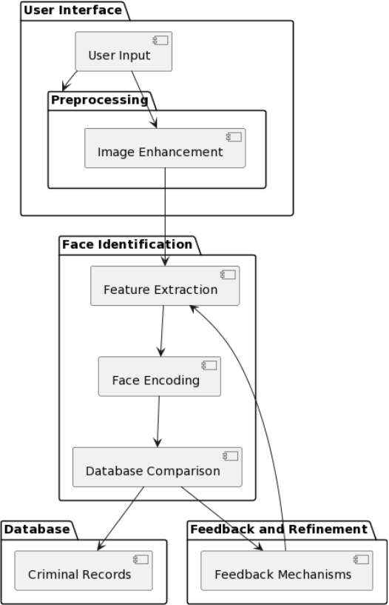
3.3 Project Architecture
3.3.1 Architectural Diagram:

Slide 17
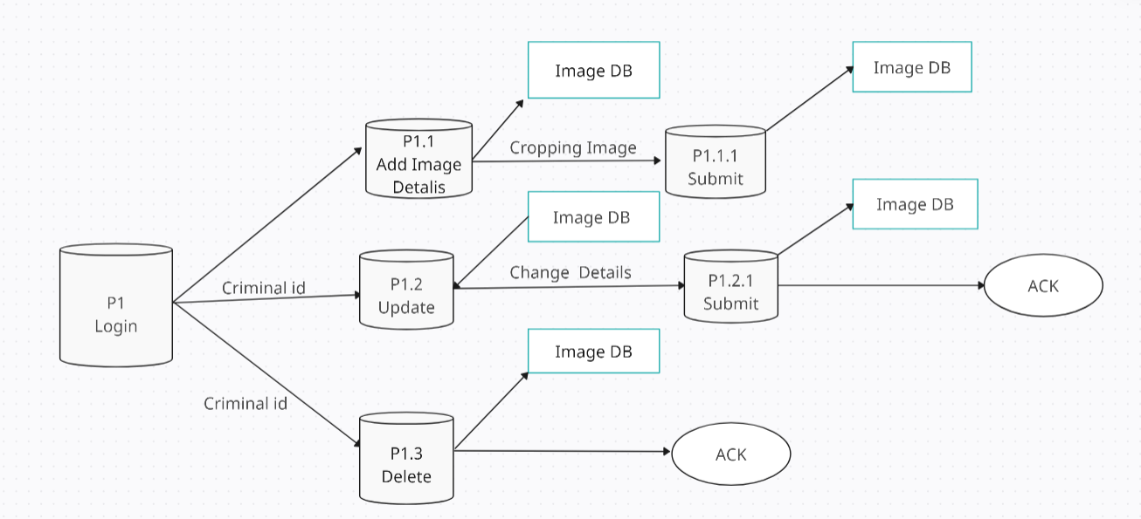
3.3.2 Data Flow Diagram:

Slide 18
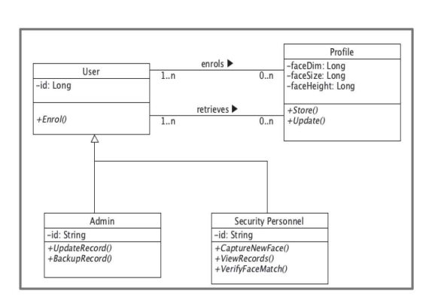
3.3.3 Class Diagram:

Slide 19
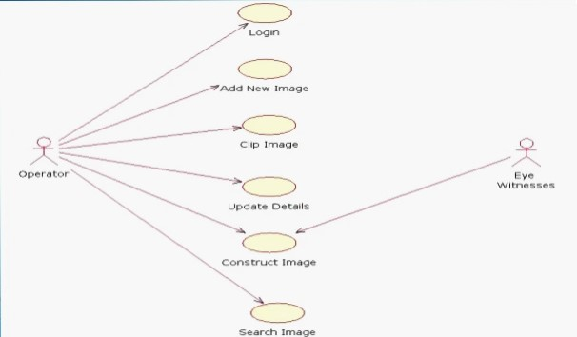
3.3.4 Use case Diagram:

Slide 20
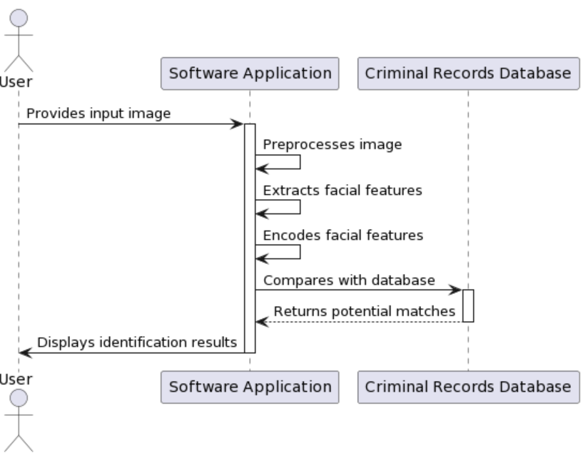
3.3.5 Sequence Diagram:

Slide 21
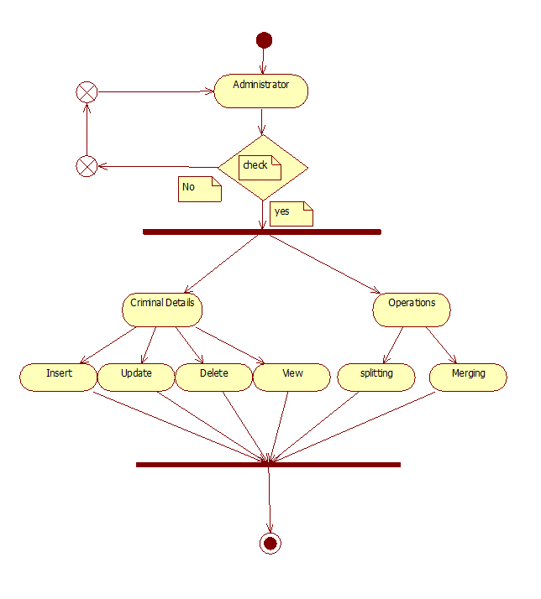
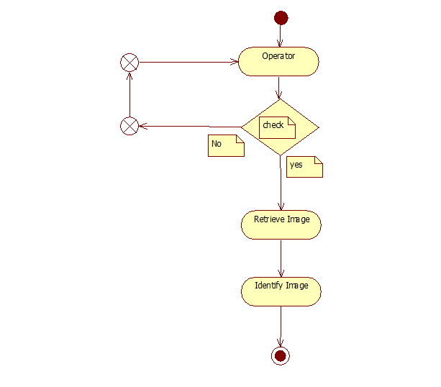
3.3.6 Activity Diagram:
Administrator:
Operator:

Slide 22
4. Implementation & Testing
4.1 Sample Code:
import java.awt.*;
import java.awt.event.*;
import javax.swing.*;
public class FaceFramingPage extends JFrame {
public FaceFramingPage() {
// Create and configure your Face Framing page components here
JLabel label = new JLabel("This is the Face Framing Page");
add(label);
setTitle("Face Framing Page");
setSize(400, 300);
setLocationRelativeTo(null); // Center the frame setDefaultCloseOperation(JFrame.DISPOSE_ON_CLOSE);
// Close only this frame, not the entire application
setVisible(true); }}

Slide 23
public void actionPerformed(ActionEvent ae) {
if (ae.getSource() == b3) {
System.out.println("Face Framing page opening");
FaceFramingPage faceFramingPage = new FaceFramingPage();
// Open the Face Framing page
}
else if (ae.getSource() == b8) {
System.out.println("Drawing of Images"); }
else if (ae.getSource() == b4) {
System.out.println("Images from Data Base");
}
}

Slide 24
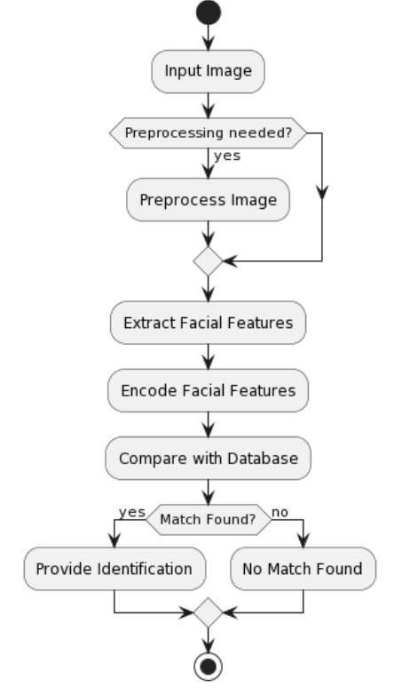
4.2 Execution Flow:

Slide 25
4.4 Testing
Test case 1:
Use Case : upload a file
Background : User wants to upload a file to the server from client.
Event Sequence:
Click file in local file view tree.
Right click and select upload.
Test case 2:
Use Case: Remove file on remote server
Background: User wants to delete a file on the server..
Event Sequence:
Select file on remote file view tree panel.
Right click and select ‘Delete’.

Slide 26
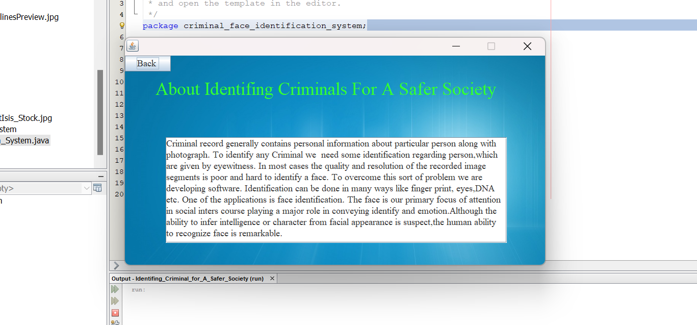
5. Results
5.1 Resulting Screens:
5.1.1 Screen shot 1

Slide 27
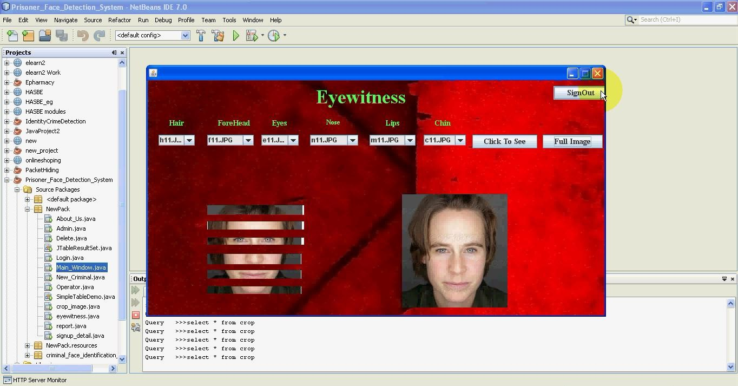
5.1.2 Screen shot 2

Slide 28
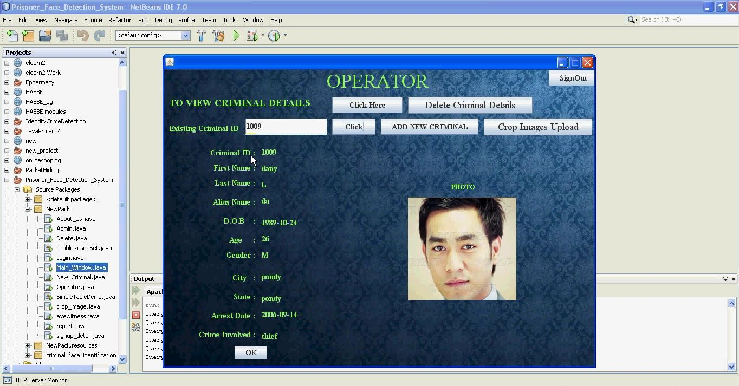
5.1.3 Screen shot 3

Slide 29
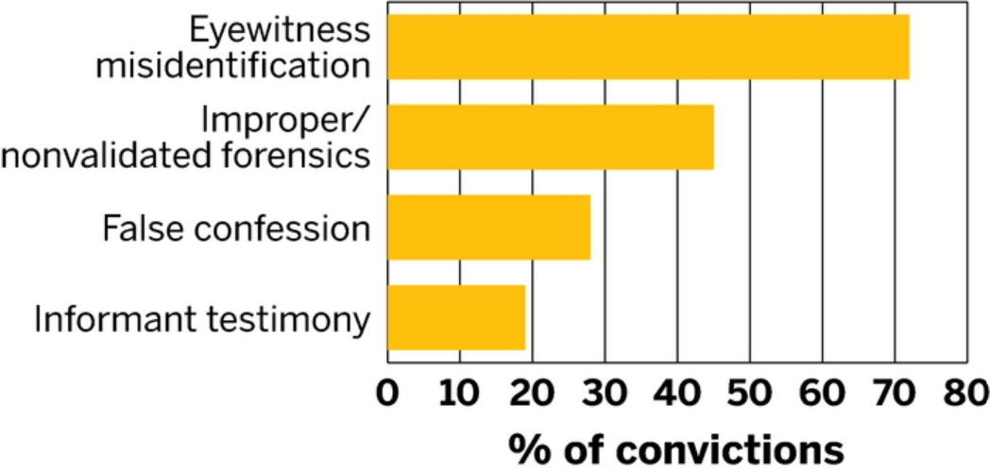
5.2 Resulting Graphs:
5.3.1 Graph 1

Slide 30
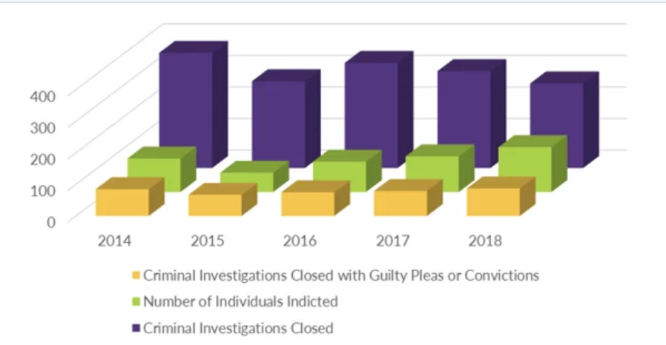
5.3.2 Graph 2

Slide 31
5.4 Results Analysis:
5.4.1 Time Complexity
Data Retrieval:
Efficiently indexed databases enable faster retrieval with time complexity dependent on database optimization. Conversely, unstructured or poorly optimized databases may incur linear time complexity relative to the record count.
Image Processing:
Face detection and feature extraction techniques exhibit varying time complexities. For example, depends on image size and features detected, while complexity of methods like eigenfaces varies with model and input size.
Matching and Recognition:
Comparing features extracted from the input image with the database involves matching algorithms.

Slide 32
5.4.2 Space Complexity
Data Storage:
Data storage for a criminal identification system encompasses space for storing criminal records, including personal data, images, and metadata, alongside additional memory allocation for indexing structures to facilitate efficient retrieval.
Image Processing:
Temporary storage for image data during processing, such as storing pixel values, feature vectors, or intermediate results.
Feature Extraction:
Space needed for extracted features or descriptors used for comparison and recognition.
5.4.3 Results Summary
A software solution is being developed to address challenges in identifying criminals, particularly when faced with poor-quality image segments and limited eyewitness descriptions. The focus is on facial identification, leveraging the human ability to recognize faces efficiently. While inferring intelligence or character from facial appearance is unreliable, recognizing faces plays a crucial role in conveying identity and emotions. The software aims to enhance identification accuracy using techniques like facial recognition alongside other methods such as fingerprint, eye, and DNA analysis.

Slide 33
6. Conclusions & Future Scope
6.1 Conclusions:
Traditionally, identifying criminals relied on manual effort, which was accurate but time-consuming. Our project aims to transform this process using machine-based face identification. Criminal information, including images, is organized in a database. These images are broken down into separate facial features like hair, eyes, nose, and lips. During investigations, eyewitness descriptions are compared to stored images to identify suspects. Advanced Image Processing Techniques help merge these features, creating a clearer picture of the suspect. This approach streamlines criminal identification, reducing reliance on manual labor and improving efficiency.
6.2 Future Scope:
Moving forward, extensive testing and debugging are imperative to refine the system, given its development within constrained time and resources. Being open-source, developers have the flexibility to augment the system with new functionalities and enhance existing ones. An area for enhancement could involve incorporating image processing capabilities to enhance the clarity of input images, enabling the system to detect faces even in lower quality images. Furthermore, integrating access to a comprehensive database containing personal information can enrich the system's functionality. Consequently, once the Facial Recognition and Criminal Identification (FRCI) system analyzes a face, it can seamlessly provide relevant personal details associated with the individual

Slide 34
Bibliography
Java (Swing & XML):
Java in a NutShell O’Rielly
Using Java2 Platform Joseph Weber
The Complete Reference Java 1.2 Herbert Schildt
Core Java Kenneth Paul
System Development:
Fundamentals Of System Concepts Jerry Fitz Gerald
System Analysis And Design Elias M. Awad
Object Oriented Modeling And Design James Rumabah

Slide 35


